Slide 1
EE 735 (Microelectronics Simulations Lab)
Assignment 1
Exploring 2D Laplace Solver

Slide 2
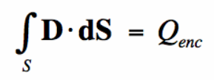

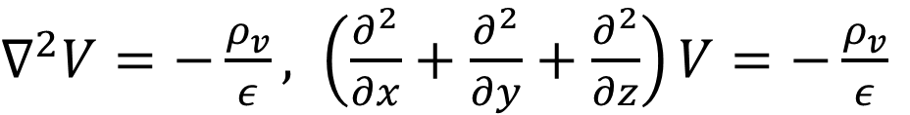
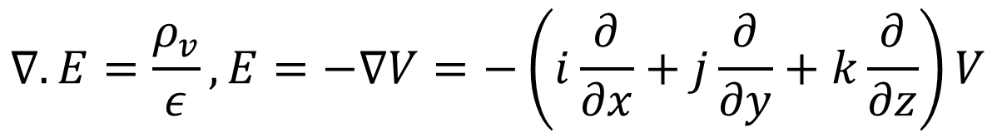
Gauss’s Law and Poisson Equation
The electric flux through a closed surface is proportional to the total electric charge enclosed by that surface.
*
$$∇.E=\frac{ρ_{v}}{ε}, E=−∇V=−\left(i\frac{∂}{∂x}+j\frac{∂}{∂y}+k\frac{∂}{∂z}\right)V$$
$$∇.D= ρ_{v},D=εE$$
$∇^{2}V=−\frac{ρ_{v}}{ε}, \left(\frac{∂^{2}}{∂x}+\frac{∂^{2}}{∂y}+\frac{∂^{2}}{∂z}\right)V=−\frac{ρ_{v}}{ε}$
*maxwells-equations.com

Slide 3
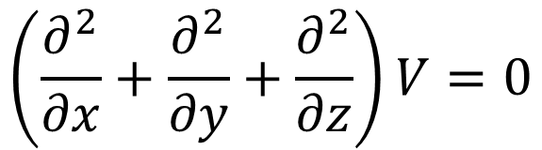

Laplace Equation
It is a partial differential equation describing a scalar function's distribution over space.
It is a special case of the Poisson equation.
Since it is time-independent, so describes the steady-state behavior of a scalar function in space.
$$∇^{2}V=0$$
$$\left(\frac{∂^{2}}{∂x}+\frac{∂^{2}}{∂y}+\frac{∂^{2}}{∂z}\right)V=0$$

Slide 4

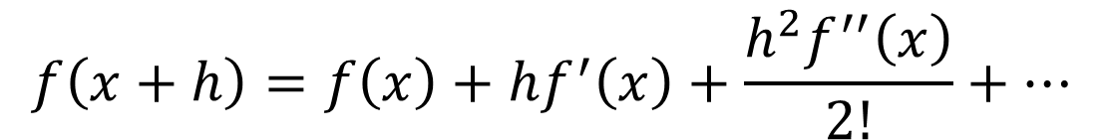










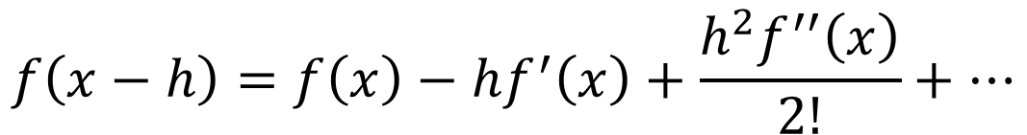
Discretization of Space and Derivatives
Computers solve only discrete numbers
Space can be discretized in x, y, and z directions by choosing an appropriate number of points.
$$V_{i−1,j+1}$$
$$V_{i,j+1}$$
$$V_{i+1,j+1}$$
$${∆y}_{i,j}$$
$$V_{i−1,j}$$
$$V_{i,j}$$
$$V_{i+1,j}$$
$$V_{i−1,j−1}$$
$$V_{i,j−1}$$
$$V_{i+1,j−1}$$
$$f\left(x+h\right)=f\left(x\right)+hf^{′}\left(x\right)+\frac{h^{2}f^{′′}\left(x\right)}{2!}+…$$
$${∆x}_{i,j}$$
$$f\left(x−h\right)=f\left(x\right)−hf^{′}\left(x\right)+\frac{h^{2}f^{′′}\left(x\right)}{2!}+…$$

Slide 5
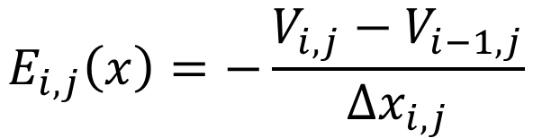
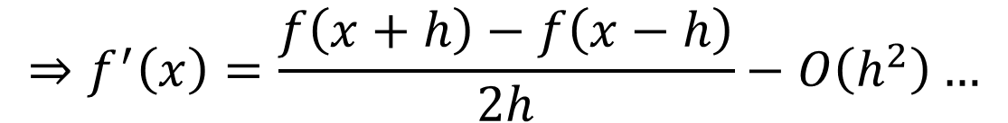
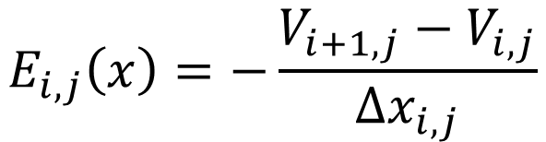
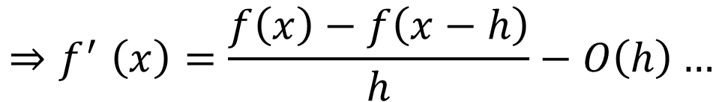
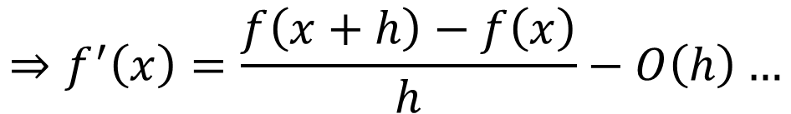
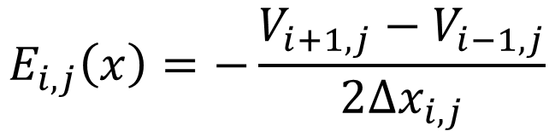
Discretization of Space and Derivatives
Forward Difference
$$E_{i,j}\left(x\right)=−\frac{V_{i+1,j}−V_{i,j}}{{∆x}_{i,j}}$$
$$⇒f^{′}\left(x\right)=\frac{f\left(x+h\right)−f\left(x\right)}{h}−O\left(h\right)…$$
Backward Difference
$$E_{i,j}\left(x\right)=−\frac{V_{i,j}−V_{i−1,j}}{{∆x}_{i,j}}$$
$${⇒f}^{′}\left(x\right)=\frac{f\left(x\right)−f\left(x−h\right)}{h}−O\left(h\right)…$$
Central Difference
$$E_{i,j}\left(x\right)=−\frac{V_{i+1,j}−V_{i−1,j}}{{2∆x}_{i,j}}$$
$$⇒f^{′}\left(x\right)=\frac{f\left(x+h\right)−f\left(x−h\right)}{2h}−O\left(h^{2}\right)…$$

Slide 6
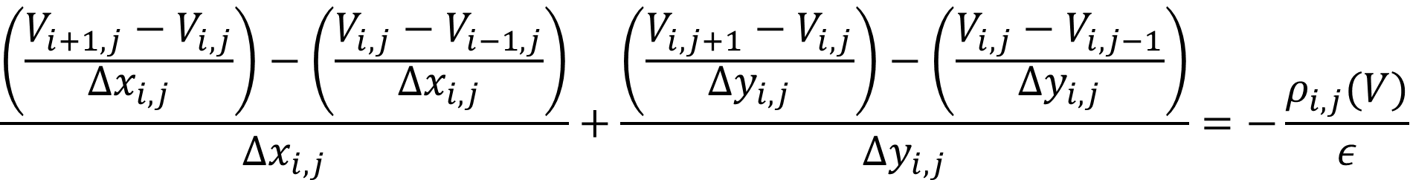
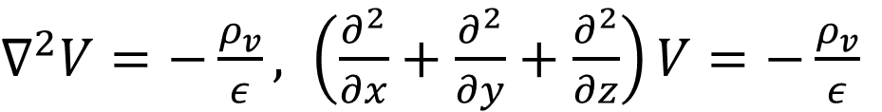
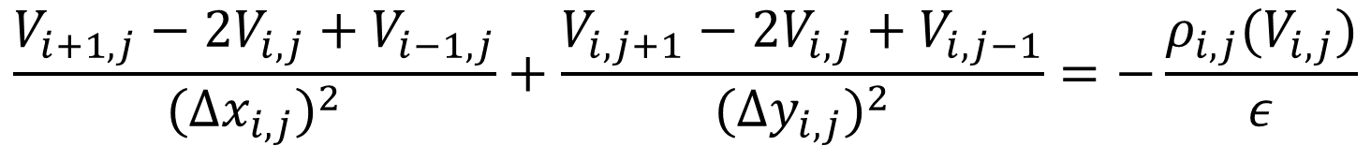
Discretization of 2D Poisson’s Equation
$∇^{2}V=−\frac{ρ_{v}}{ε}, \left(\frac{∂^{2}}{∂x}+\frac{∂^{2}}{∂y}+\frac{∂^{2}}{∂z}\right)V=−\frac{ρ_{v}}{ε}$
$$\frac{\left(\frac{V_{i+1,j}−V_{i,j}}{{∆x}_{i,j}}\right)−\left(\frac{V_{i,j}−V_{i−1,j}}{{∆x}_{i,j}}\right)}{{∆x}_{i,j}}+\frac{\left(\frac{V_{i,j+1}−V_{i,j}}{{∆y}_{i,j}}\right)−\left(\frac{V_{i,j}−V_{i,j−1}}{{∆y}_{i,j}}\right)}{{∆y}_{i,j}}=−\frac{ρ_{i,j}(V)}{ε}$$
$$\frac{V_{i+1,j}−2V_{i,j}+V_{i−1,j}}{{({∆x}_{i,j})}^{2}}+\frac{V_{i,j+1}−2V_{i,j}+V_{i,j−1}}{{({∆y}_{i,j})}^{2}}=−\frac{ρ_{i,j}(V_{i,j})}{ε}$$

Slide 7
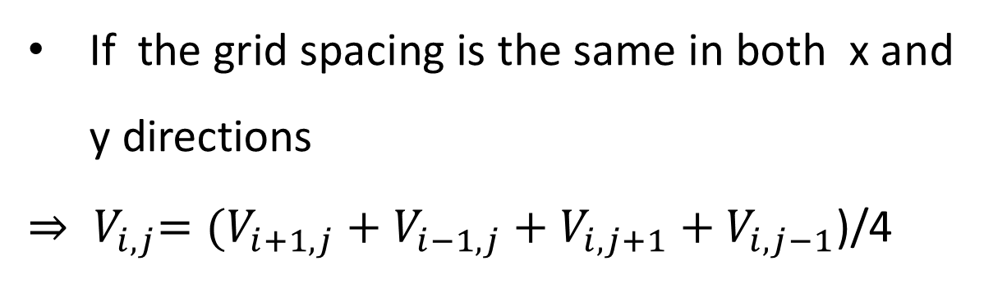
The problem of a parallel plate capacitor
If the grid spacing is the same in both x and y directions
${{{⇒ V}_{i,j}=(V}_{i+1,j}+V_{i−1,j}+V}_{i,j+1}+V_{i,j−1}$)/4
+1V
t
d
-1V
L
At each point, take the average of potential values at the nearest 4 points
Keep iterating till a target error is reached
$$V_{i−1,j+1}$$
$$V_{i,j+1}$$
$$V_{i+1,j+1}$$
$${∆y}_{i,j}$$
$$V_{i−1,j}$$
$$V_{i,j}$$
$$V_{i+1,j}$$
$$V_{i−1,j−1}$$
$$V_{i,j−1}$$
$$V_{i+1,j−1}$$
$${∆x}_{i,j}$$

Slide 8
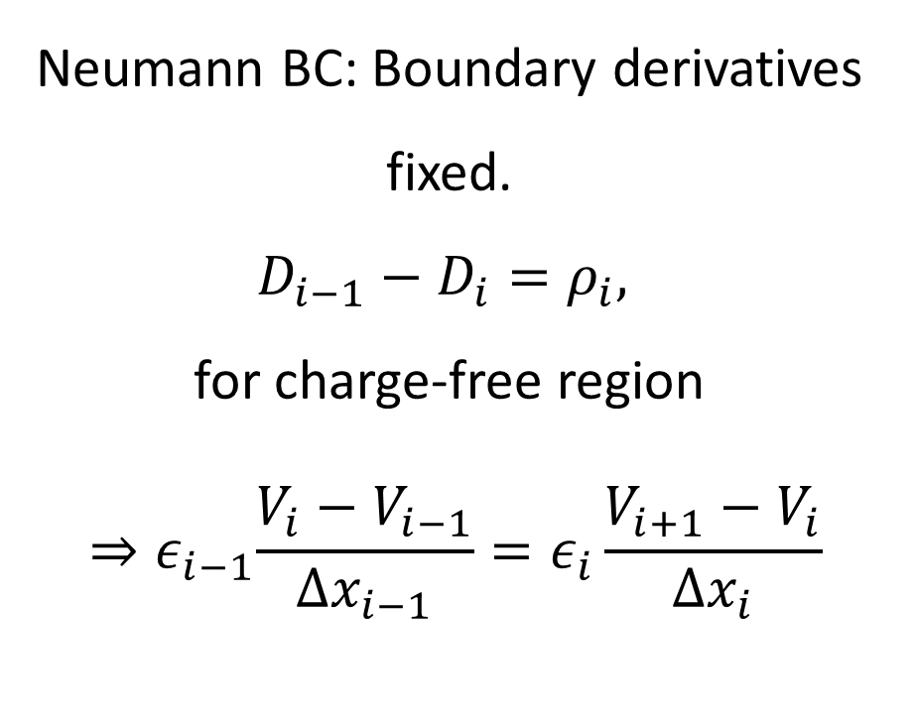
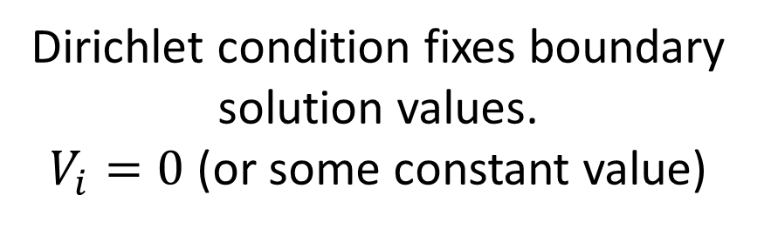
Significance of Boundary Conditions
It is a set of specifications imposed on a mathematical equation to determine the behavior of a system within a specific region.
Dirichlet Boundary Condition
Neumann Boundary Condition
Neumann BC: Boundary derivatives fixed.
$D_{i−1}−D_{i}=ρ_{i},$
for charge-free region
$${ ⇒ε}_{i−1}\frac{V_{i}−V_{i−1}}{{∆x}_{i−1}}=ε_{i}\frac{V_{i+1}−V_{i}}{{∆x}_{i}}$$
Dirichlet condition fixes boundary solution values.
$V_{i}=0$ (or some constant value)

Slide 9
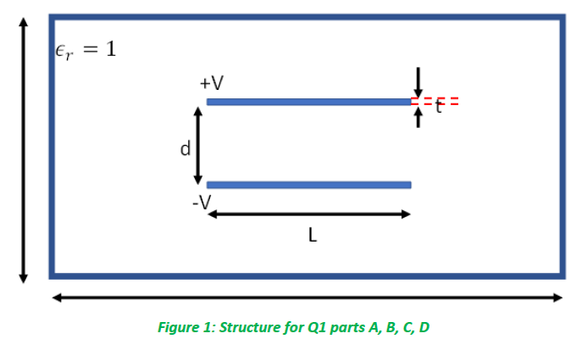
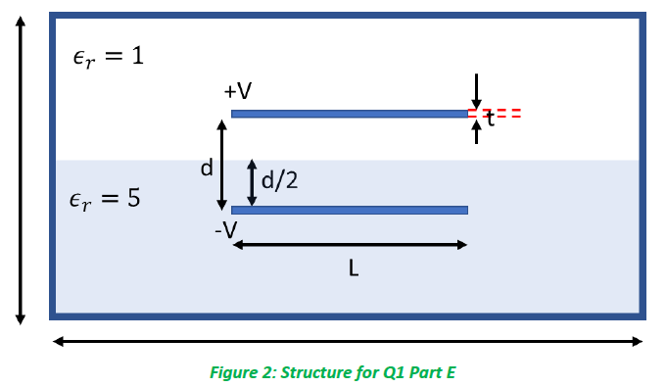
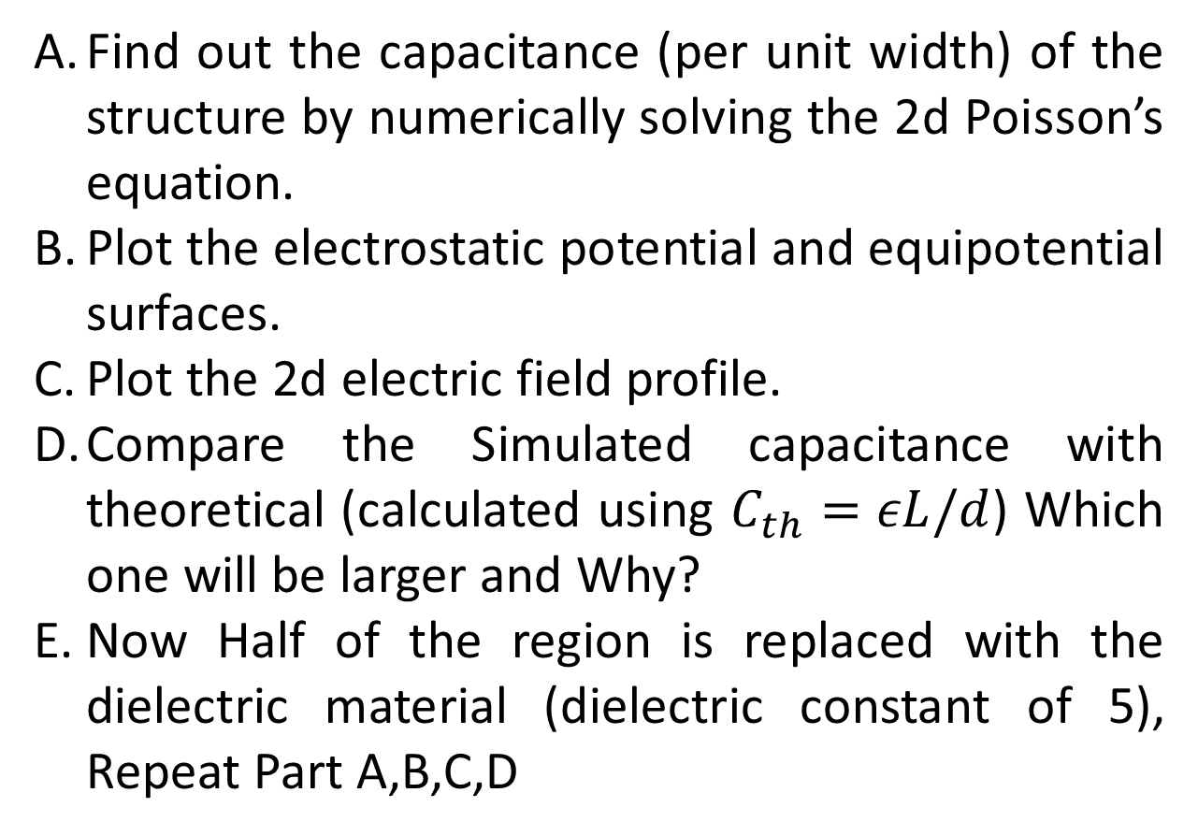
Assignment: Problem 1
Find out the capacitance (per unit width) of the structure by numerically solving the 2d Poisson’s equation.
Plot the electrostatic potential and equipotential surfaces.
Plot the 2d electric field profile.
Compare the Simulated capacitance with theoretical (calculated using $C_{th}=εL/d$) Which one will be larger and Why?
Now Half of the region is replaced with the dielectric material (dielectric constant of 5), Repeat Part A,B,C,D

Slide 10
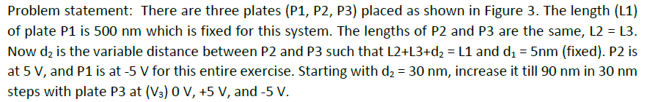
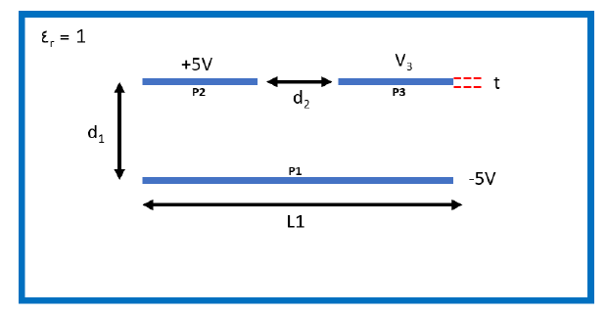
Assignment: Problem 2
A. Find out the capacitance (per unit width) of the structure by numerically solving the 2d Poisson’s equation for all 9 cases. (Hint: First fix the voltage level of P3 and change d2 or vice-versa)
B. Plot the electrostatic potential and equipotential surfaces for all cases.
C. Plot the 2d electric field profile and find out the position of the maximum electric field for all cases.
D. Note and explain the observations from your simulation results of A, B, and C.

Slide 11
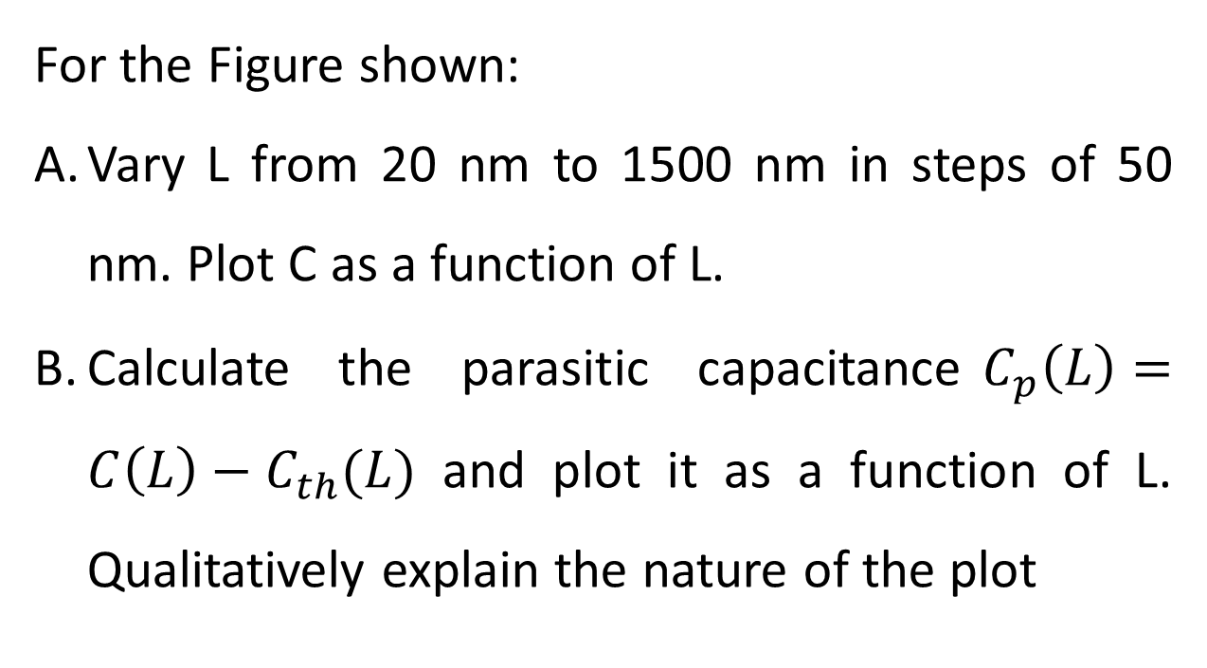
Assignment: Problem 3
For the Figure shown:
Vary L from 20 nm to 1500 nm in steps of 50 nm. Plot C as a function of L.
Calculate the parasitic capacitance$C_{p}\left(L\right)=C\left(L\right)−C_{th}(L)$ and plot it as a function of L. Qualitatively explain the nature of the plot

Slide 12
Appendix
Analytical solution of 2D Laplace equation - https://www.youtube.com/watch?v=2aJ3fFwET68
MIT Numerical Methods for PDE Lecture 3: Finite Difference for 2D Poisson's equation - https://www.youtube.com/watch?v=bLiaz-IHX_Y
Solution of Laplace Equation with 9 mesh squares || Numerical Methods || Dr Prashant Patil - https://www.youtube.com/watch?v=4ZLCNHGim8E
Numerical solution of Partial Differential Equations - https://www.youtube.com/watch?v=N6Nt5NeCTSk

Slide 13
Thank You! Questions?

